Slide 1
Electronic Devices
Final Term Lecture - 09
Reference book:
Electronic Devices and Circuit Theory (Chapter-8)
Robert L. Boylestad and L. Nashelsky , (11th Edition)

Slide 2
OBJECTIVES
Become acquainted with the small-signal ac model for a JFET and MOSFET.
Be able to perform a small-signal ac analysis of a variety of JFET and MOSFET configurations.
Begin to appreciate the design sequence applied to FET configurations.
Understand the effects of a source resistor and load resistor on the input impedance, output impedance and overall gain.
Be able to analyze cascaded configurations with FETs and/or BJT amplifiers.

Slide 3


Introduction
Field-effect transistor amplifiers provide an excellent voltage gain with the added feature of a high input impedance.
JFET Small-Signal Model
The ac analysis of a JFET Configuration requires that a small-signal ac model for the JFET be developed.
The gate-to-source voltage controls the drain-to-source (channel) current of a JFET.
The change in drain current that will result from a change in gate-to-source voltage can be determined using the transconductance factor gm in the following manner:

Slide 4

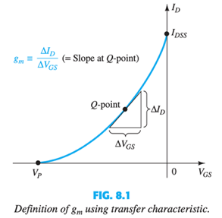
Graphical Determination of g_{m}

Slide 5
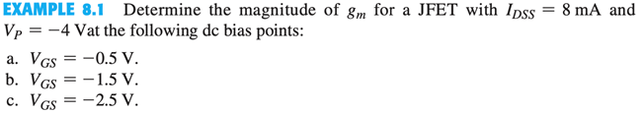
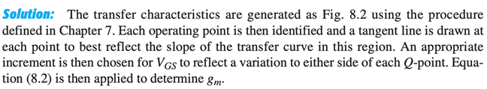
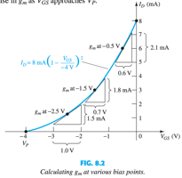
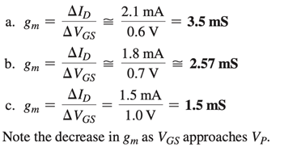
Example:

Slide 6
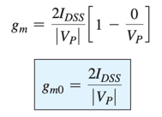

Mathematical Definition of g_{m}
The derivative of a function at a point is equal to the slope of the tangent line drawn at that point.

Slide 7

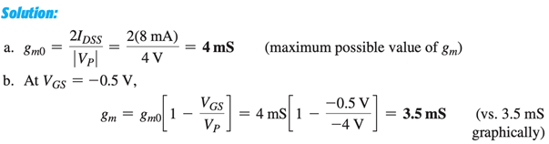


Example

Slide 8


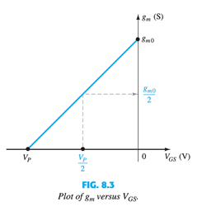
Plotting g_{m} versus V_{GS}

Slide 9
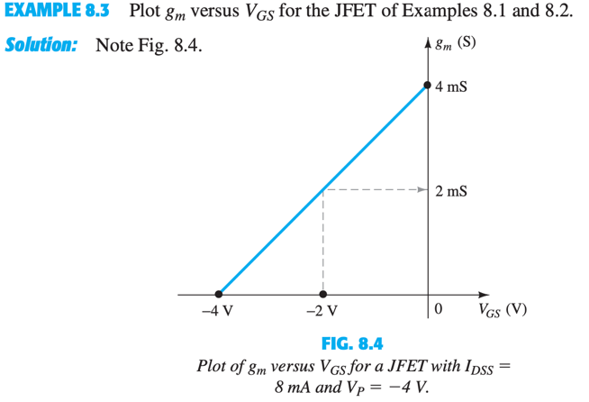
Example

Slide 10
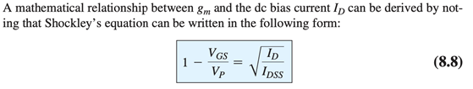

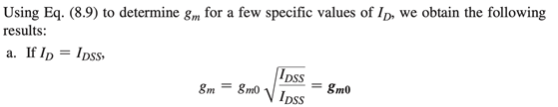
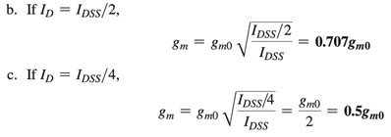
Effect of I_{D} on g_{m}

Slide 11
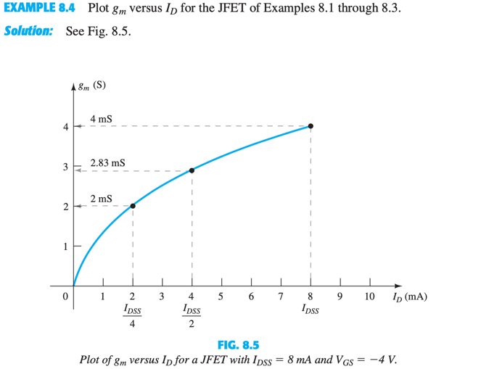
Example

Slide 12
End of Lecture-9

